Slide 1

Android Programming

Slide 2

Outline
Preparation
Create new project
Build and Run a project
Debug a project
Deploy on devices

Slide 3
Preparation
SDK
  Download latest Android SDK
IDE
  Download Eclipse(3.5)
  Install ADT plug-in for Eclipse from
    https://dl-ssl.google.com/android/eclipse/
Create Emulator

Slide 4
Preparation
Create Emulator
  Target of Emulator: base on Android Platform from Android 1.0 to Android 2.1
    Android 1.0 -> target: 1
    Android 1.1 -> target: 2
    Android 2.1 ->target: 7
  Create from comand-line(cmd)
    Point to “tools” folder of android SDK
    Command: android create avd --target 2 --name my_avd

Slide 5
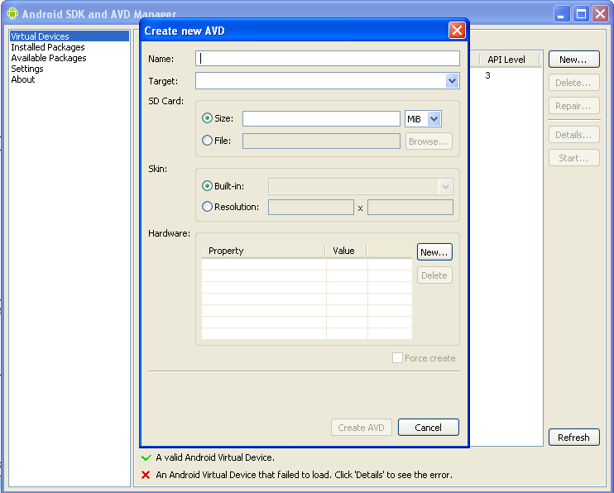
Preparation
Create Emulator
  Create from AVD Manager:

Slide 6
Create new project
From Eclipse: File → New → Project → Android → Android Project. Click Next.
On next screen:
  Project name: Name of project on Eclipse
  Application name: Name to be appeared
  Package name: define your java package
  Create Activity: if it’s checked, Eclipse will create an Activity to be started first in application
  MinSDK: application will be built on which target

Slide 7
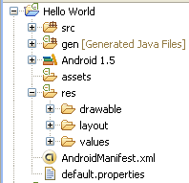
Create new project
Project Structure:
  Src: Source code
  Gen include R.java: auto-generated file that contain id of project’resource.
  Assets: resource used directly
  AndroidManifest.xml:
    essential information about the application to the Android system
  Res: resource used through id
    Drawable: image, xml
    Layout: xml
    Value: xml

Slide 8
Hello world project
After create new project, eclipse will automatic create an activity to start
  public class HelloAndroid extends Activity {
  /** Called when the activity is first created. */
  @Override
  public void onCreate(Bundle savedInstanceState) {
  super.onCreate(savedInstanceState);
  setContentView(R.layout.main);
  }
  }
  R is auto-generated file contains id of resource
  R.layout.main is id of main layout

Slide 9
Hello world project
Layout: main.xml in folder res/layout
<?xml version="1.0" encoding="utf-8"?>
<TextView xmlns:android="http://schemas.android.com/apk/res/android"
android:layout_width="fill_parent"
android:layout_height="fill_parent"
android:text=“Hello world"/>

Slide 10
Build and run a project
Build: create .apk file in bin folder
  By default, project will be built automatically when we save project.
  Uncheck build automatically on Project menu to disable automatic build. To build project manual, right click on project → build
Run:
  Right click on Project → Run as → Android
  If emulator is not running, eclipse will open it.

Slide 11
Debug
Debug an application from beginning:
  Right click on Project name → Debug as → Android application
  Application will launch with debug
Debug use DDMS(Dalvik Debug Monitor Server)
  Open DDMS on eclipse
  Open DDMS in folder tools of SDK

Slide 12
Debug
Debug use DDMS:
  DDMS: tools for debugging job
  Manage emulators and devices
  Can monitor running applications
  Monitor memory of application
  Send an event to emulator: send SMS or make a call to emulator
  Debug when needed

Slide 13
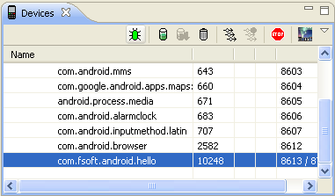
Debug
Debug use DDMS:
  When application was launched, chose application package on device tab of DDMS
  Click on green icon to begin debug process this application

Slide 14
Debug
Debug use Logcat
  Android system write log of all application include error and log of application
  Logcat is a part of DDMS to read log file of emulators or devices
  Application can print information to log by use:
    System.out.println(information)
    Log class
      Log.d(Tag,information)

Slide 15
Deploy on devices
Sign application
  To put application on market
Deploy on devices
  Use command line: adb install “filename.apk”
  Copy apk file to SD Card, use File Explorer to install application
Uninstall
  Use command line: adb uninstall “packagename”
  User application manager of Android to uninstall

Slide 16

The end

